Slide 1
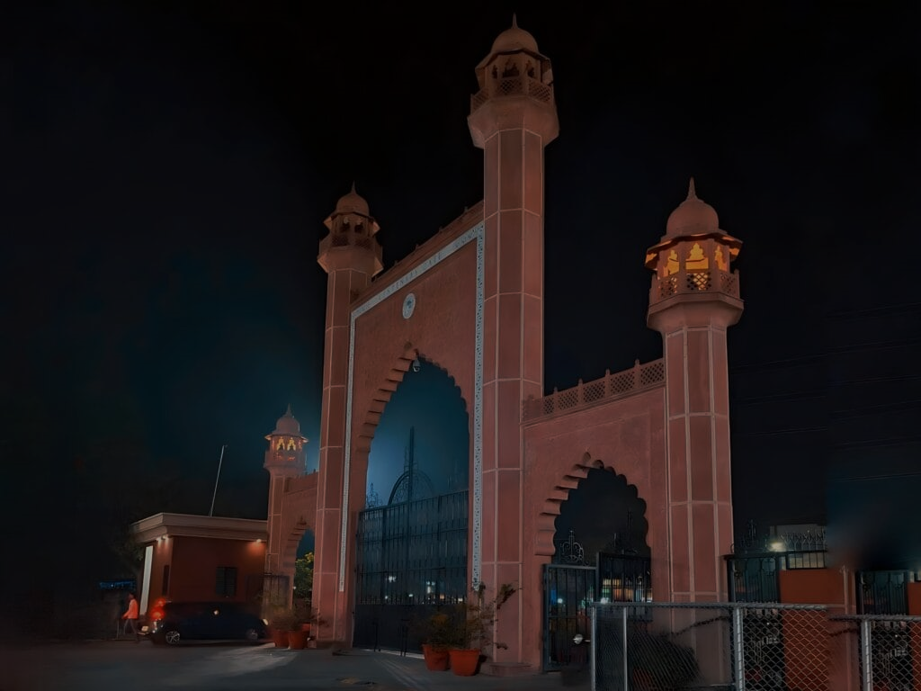

Aligarh Muslim university
“The first requisite for the progress of a nation is brotherhood and unity among all sections of society.”
- Sir Syed Ahmad Khan
"Heritage • Excellence • Future"
Special Edition | Centenary Reflections
“Vol. 1 | Issue 2025”

